Slide 1
ECE 143 PROJECT
Gun Violence Data Analysis
Shashank Shastry, Peiyu Si, Yihan Hu
11/30/2018

Slide 2
INTRODUCTION
Gun violence is a common problem in USA, and our project is aimed at analyzing the trends and causes of these incidents
Data - Comprehensive record of over 260,000 gun violence incidents in USA from 2013-2018
Data fields such as Date, Location (State, Address, Latitude, Longitude), Casualties (Killed, Injured), Logistics (Guns stolen, Number of guns involved, Gun type), Persons involved (Age, Gender, Type)

Slide 3
PEOPLE TRENDS
Shashank Shastry

Slide 4
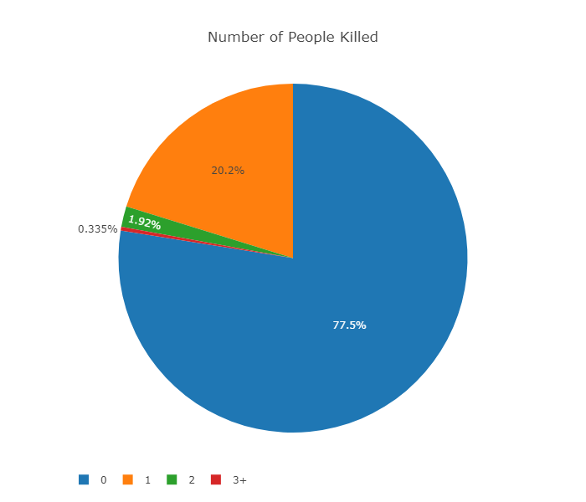
Number of deaths distribution
Notes:
Nobody killed in most incidents. 1 death in 20% of incidents. Very few incidents with more than 2 deaths.

Slide 5
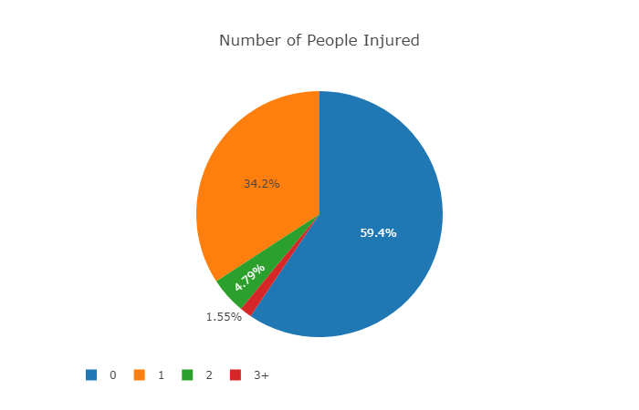
Number of injuries distribution
Notes:
Similar to previous graph, most incidents have 0 injuries, and some have 1 injury.
Fraction with 0 injuries lesser than fraction with 0 deaths - injuries are easier to cause than death.

Slide 6
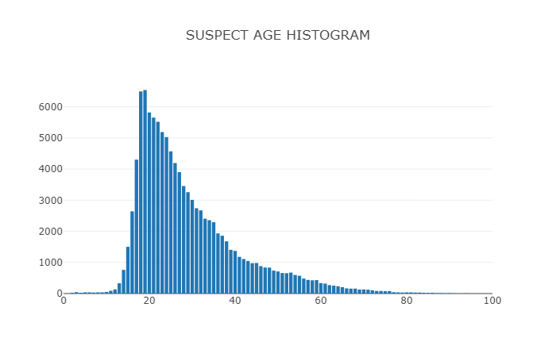
Suspect age distribution
Notes:
Most suspects in age group - 17 to 40 , peak at 17 to 20
Very low for ages < 12 or > 80 - Limited access or capability to use guns

Slide 7
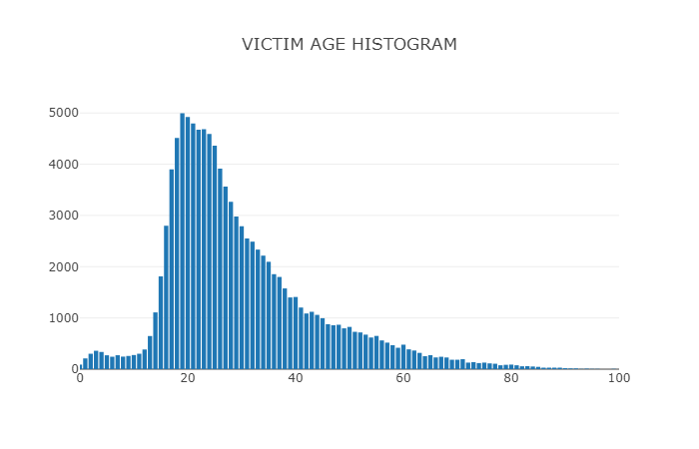
Victim age distribution
Notes:
Similar to suspect distribution, but not very low even at very low and high ages - which is unfortunate.

Slide 8
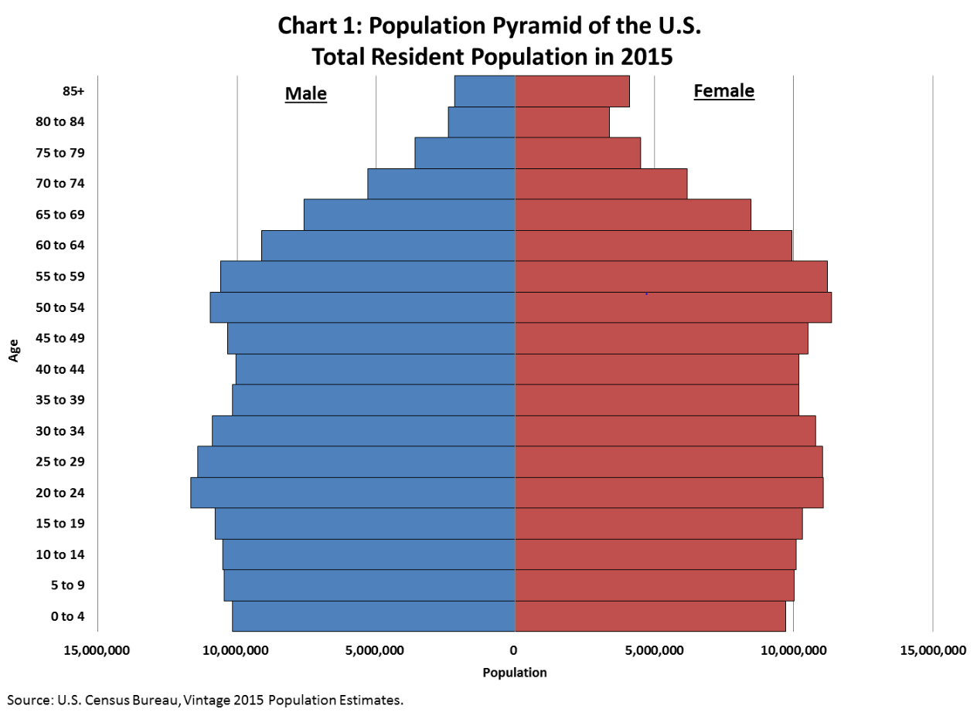
Notes:
Age distribution of suspects and victims can be partially explained by age distribution of population - high at 20s, low after 60s - but cannot be completely accounted - much sharper peak around 20 years in previous graphs.

Slide 9
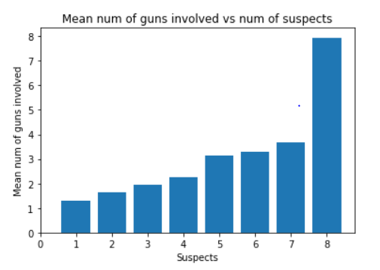
Number of guns vs suspects
Notes:
Mean number of guns involved increases with number of suspects - as expected.

Slide 10
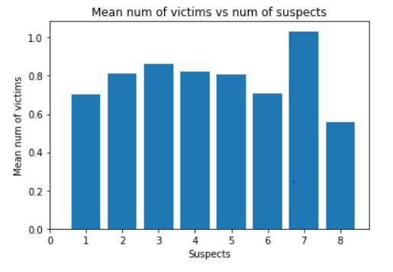
Number of victims vs suspects
Notes:
Mean number of victims does not increase with suspects unlike number of guns - maybe its a larger group of people attacking the same smaller group.

Slide 11
ANALYSIS OF TIME RELATED TRENDS
Peiyu Si

Slide 12
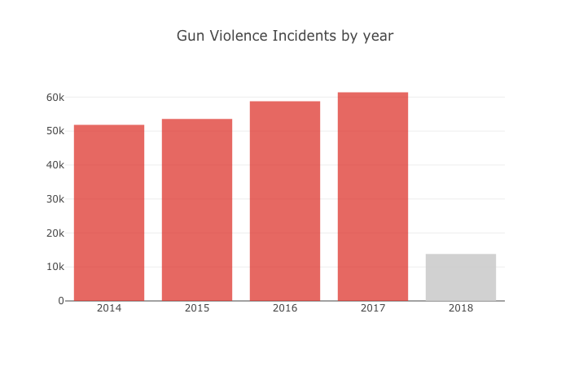
ANALYSIS OF TIME RELATED TRENDS (YEAR)

Slide 13
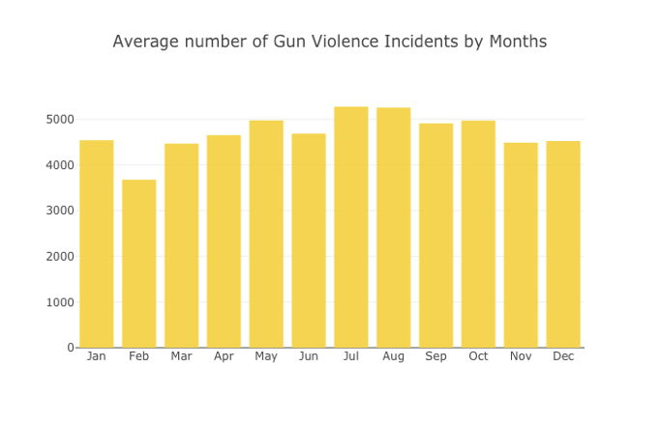
ANALYSIS OF TIME RELATED TRENDS (MONTH)

Slide 14
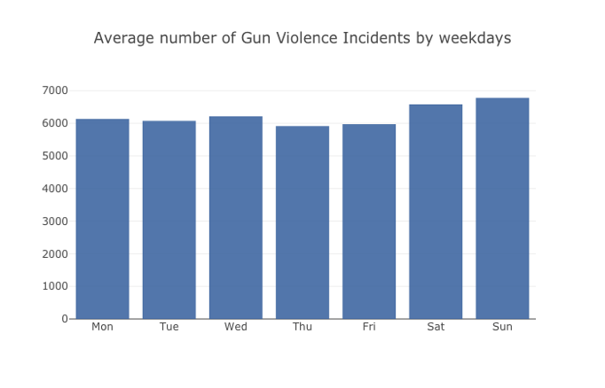
ANALYSIS OF TIME RELATED TRENDS (WEEKDAY)

Slide 15
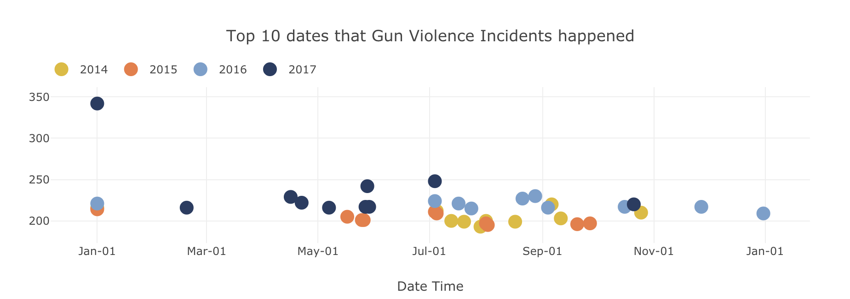
THE MOST DANGEROUS DATES

Slide 16
ANALYSIS OF THE NUMBER OF GUN REGISTERED BY STATE
Peiyu Si

Slide 17
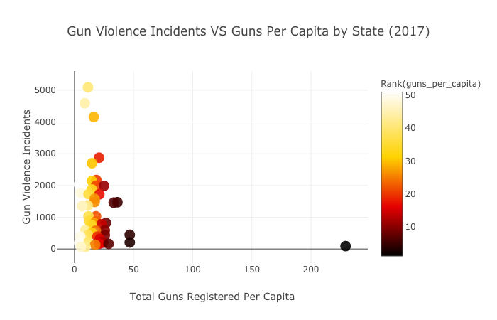
ANALYSIS OF THE NUMBER OF GUN REGISTERED
Illinois
California
Florida
Wyoming

Slide 18
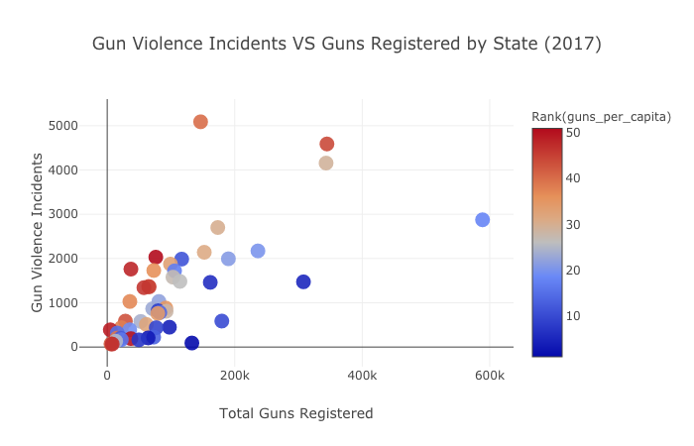
ANALYSIS OF THE NUMBER OF GUN REGISTERED
Illinois
California
Florida
Texas
Notes:
Texas owns highest number of guns across America, but there number of incidents are not much higher than other states. However, data points which stand for CA, IL and FL suggest more guns mean more incidents.

Slide 19
LOCATION RELATED ANALYSIS
Yihan Hu

Slide 20
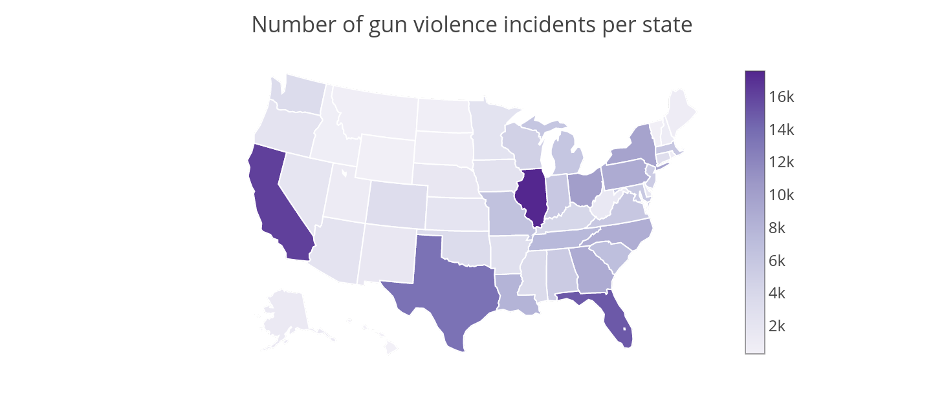
STATE WISE INCIDENTS NUMBER
Notes:
Illinois State has highest number of gun violence incidents over past 5 years， the total number is over 17k. Then, It is followed by California Florida and Texas. However, the data is not adjusted by the population since IL,CA,TX has most population among US states.

Slide 21
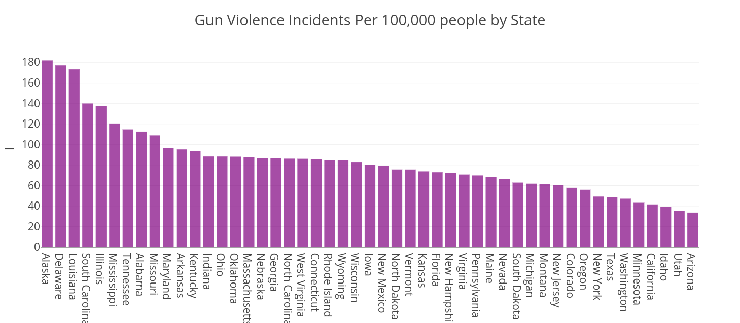
STATE WISE INCIDENTS NUMBER PER 100K PEOPLE
I’m here
Notes:
Then we normalized data with population. Alaska has the highest number of gun violence incidents per 100,000 people.while Arizona, Utha, and Idaho(aidaho) and CA are the states with least number of incidents in population adjusted dataset. Interesting to see that California which is one of the top states with high number of gun violence incidents ranks low in population adjusted dataset. However, Illinois still comes in top 5 states .

Slide 22
CAUSE ANALYSIS
Yihan Hu
Notes:
Then we try to analysis causes for gun violence

Slide 23
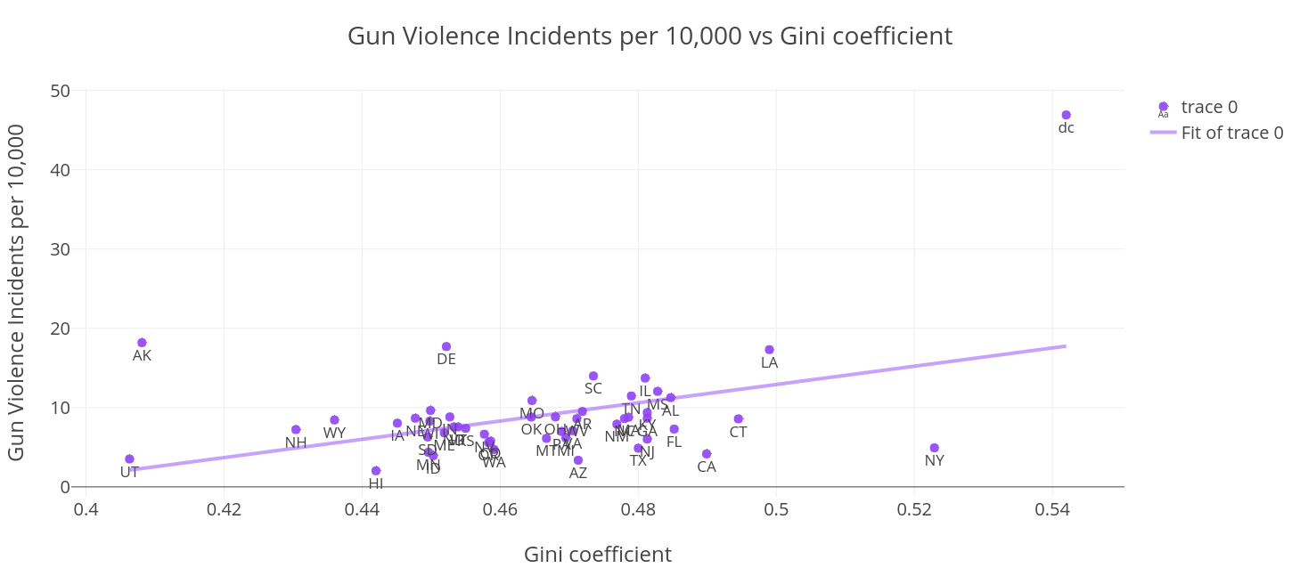
INCIDENTS VS GINI COEFFICIENT
Notes:
We first explore the relationship between the social inequality and incidents rate.
Gini coefficient measure the wealth distribution among a population. Intuitively, The larger of gini coefficient, the more inequality in wealth distribution.
We collect the gini coefficient on the internet and plot incidents rate vs gini coefficient in each state. As we can see, the whole data present positive correlation between incidents rate and gini coefficient in each state. Specifically, Washington dc has both highest incidence rate and gini coefficient.Linear regression also shows that there is positive correlation between this two, Which means more wealth inequality is usually associated with higher gun violence rate for each state..
(A country in which every resident has the same income would have an income Gini coefficient of 0. A country in which one resident earned all the income, while everyone else earned nothing, would have an income Gini coefficient of 1)

Slide 24
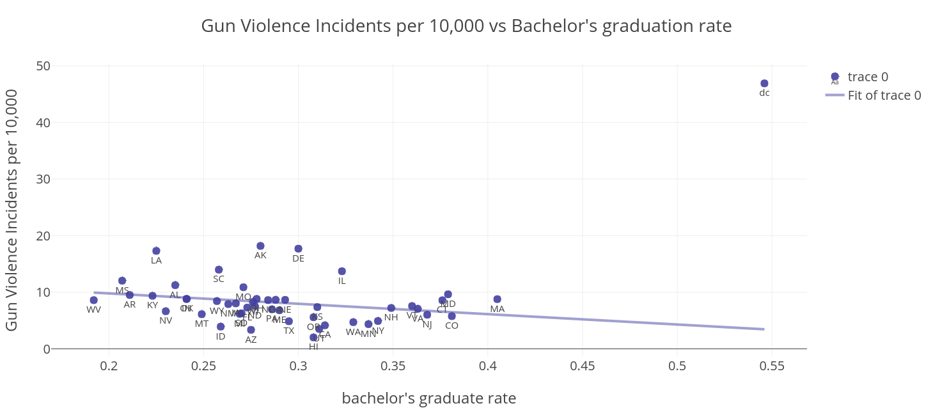
BACHELOR’S GRADUATION VS INCIDENTS
Notes:
Next, we explored the relation between incidents rate and education. We collect the graduation rate data on the internet and plot bachelors Graduation rate vs incidents rate in each state. except for the abnormal point Washington dc, the whole data present negative correlation between incidents and education. Which means better education lowers the gun violence rate.

Slide 25
CONCLUSIONS
High concentration of gun violence incident suspects in age group 18 to 25.
Most incidents occured in federal holidays and among them July 4th and 5th are the most dangerous dates.
Strong correlation between Gini index (positive) and Education level (negative) with gun violence incidents.
These facts should be kept in mind when trying to reduce gun violence.
Notes:
Then we try to analysis causes for gun violence

Slide 26
THANK YOU
Questions?
Notes:
Then we try to analysis causes for gun violence

